Slide 1
“Atmospheric Turbulence Mitigation"
Semester Project Review
- Rahhul J(EP20BTECH11019)

Slide 2
Overview:
In this Presentation, we will discuss about the things that were done during my Semester Project on the topic: “Atmospheric Turbulence Mitigation”.
Here we will have a literature review of: “Single Frame Atmospheric Turbulence Mitigation: A Benchmark Study and A New Physics-Inspired Transformer Model” paper authored by: Zhiyuan Mao, Ajay Jaiswal, Zhangyang Wang, and Stanley H. Chan along with the code for the TurbNet Model that was proposed.
Then we will have a brief look at the model code of the Fully Connected Multi-Layer Perceptron Network designed for the objective to remove static turbulence from abberated images.

Slide 3
Literature Review
Introduction:
A part of the project is a literature review of: “Single Frame Atmospheric Turbulence Mitigation: A Benchmark Study and A New Physics-Inspired Transformer Model” paper authored by: Zhiyuan Mao, Ajay Jaiswal, Zhangyang Wang, and Stanley H. Chan.
In long-range imaging systems, atmospheric turbulence is one of the main sources of distortions that causes geometric displacements of the pixels and blurs. If unprocessed, the distorted images can have significant impacts on all downstream computer vision tasks such as detection, tracking, and biometric applications.
The atmospheric turbulence effects are substantially harder to model and mitigate compared to the commonly seen image degradations such as deconvolution, as the turbulence is an entanglement of pixel displacement, blur, and noise. As a result, a dedicated image restoration pipeline is an essential element for long-range computer vision problems.

Slide 4
Challenges with the existing Algorithms:
1) Many of the existing algorithms are based on the principle of lucky imaging that requires multiple input frames. These methods often have a strong assumption that both the camera and the moving objects are static, which can easily become invalid in many real applications.
2) The conventional algorithms are often computationally expensive, making them unsuitable for processing large-scale datasets to meet the need of the latest computer vision systems.
3) Existing deep learning solutions are not utilizing the physics of the turbulence. Many of them are also tailored to recovering faces instead of generic scenes. The generalization is therefore a question.
4) The algorithms may not be properly evaluated due to the absence of a widely accepted real large-scale benchmarking dataset.

Slide 5
Proposals:
To articulate the aforementioned challenges, in the paper three contributions were made:
A comprehensive benchmark evaluation of deep-learning based image restoration algorithms through atmospheric turbulence was presented. A sophisticated physics-grounded simulator was tuned to generate a large-scale dataset, covering a broad variety of atmospheric turbulence effects. The highly realistic and diverse dataset leads to exposing shortages of current turbulence mitigation algorithms
Realizing the existing algorithms’ limitations, a novel physics inspired turbulence restoration model was was introduced, termed TurbNet. Built on a transformer backbone, TurbNet features a modularized design that targets modeling the spatial adaptivity and long-range dynamics of turbulence effects, plus a self-supervised consistency loss.
A variety of evaluation regimes were presented and two large-scale real world turbulence testing datasets were collected, one using the heat chamber for classical objective evaluation (e.g., PSNR and SSIM), and one using real long-range camera for optical text recognition as a semantic “proxy” task.

Slide 6
Related Works:
To reconstruct a turbulence degraded image, conventional algorithms often adopt the multi-frame image reconstruction strategy. The key idea is called “lucky imaging”, where the geometric distortion is first removed using image registration or optical flow techniques. Sharper regions are then extracted from the aligned frames to form a lucky frame. A final blind deconvolution is usually needed to remove any residue blur. These methods are usually very computationally expensive.
There are also several works based on Deep Learning that focus on specific types of images, such as face restoration. They are usually based on a simplified assumption on atmospheric turbulence where they assume the blur to be spatially invariant. Such assumption cannot extend to general scene reconstruction, where the observed blur can be highly spatially varying due to a wide field of view.
Despite recent advances in turbulence mitigation algorithms, there is a very limited amount of publicly available datasets for atmospheric turbulence. Existing algorithms are all trained with synthetic data. The computationally least expensive synthesis technique is based on the random pixel displacement + blur model. Our data synthesis scheme is based on the P2S (Phase-to-Space transform) model.

Slide 7
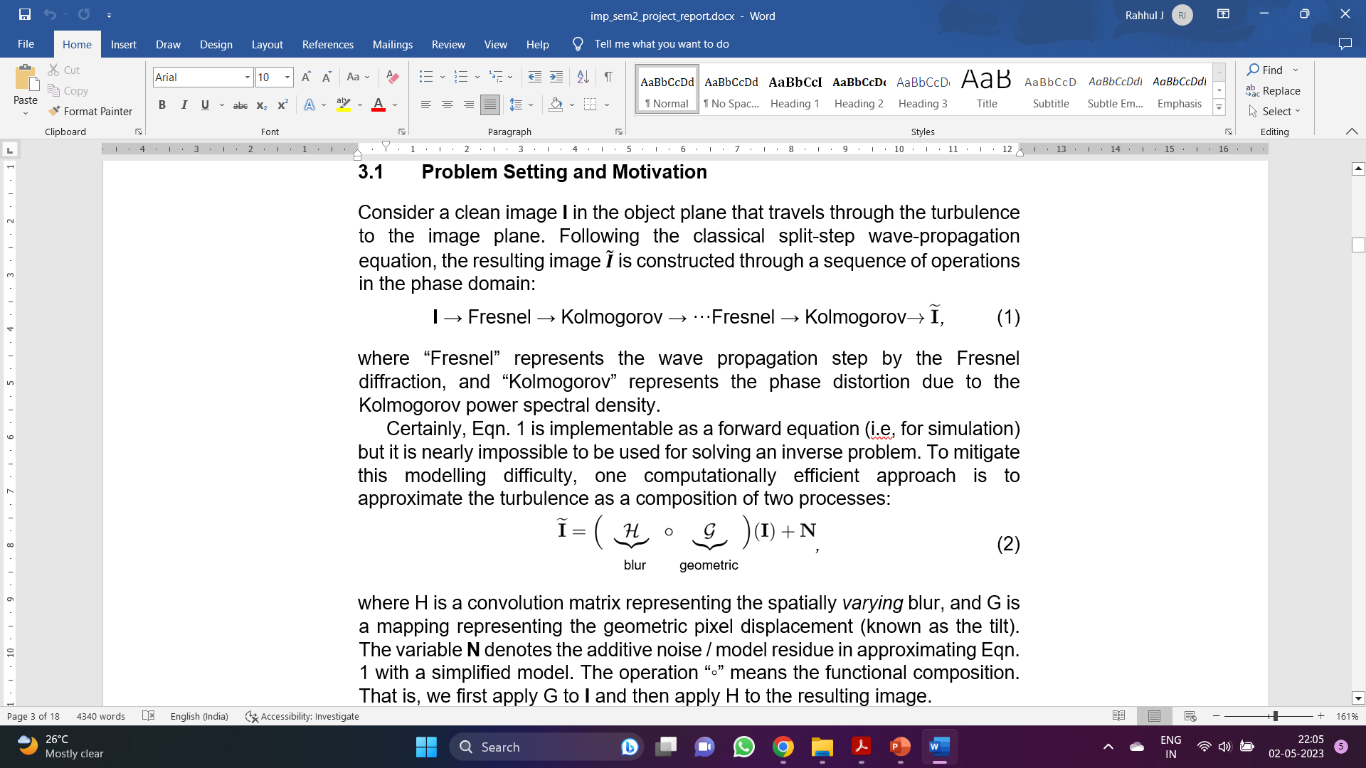
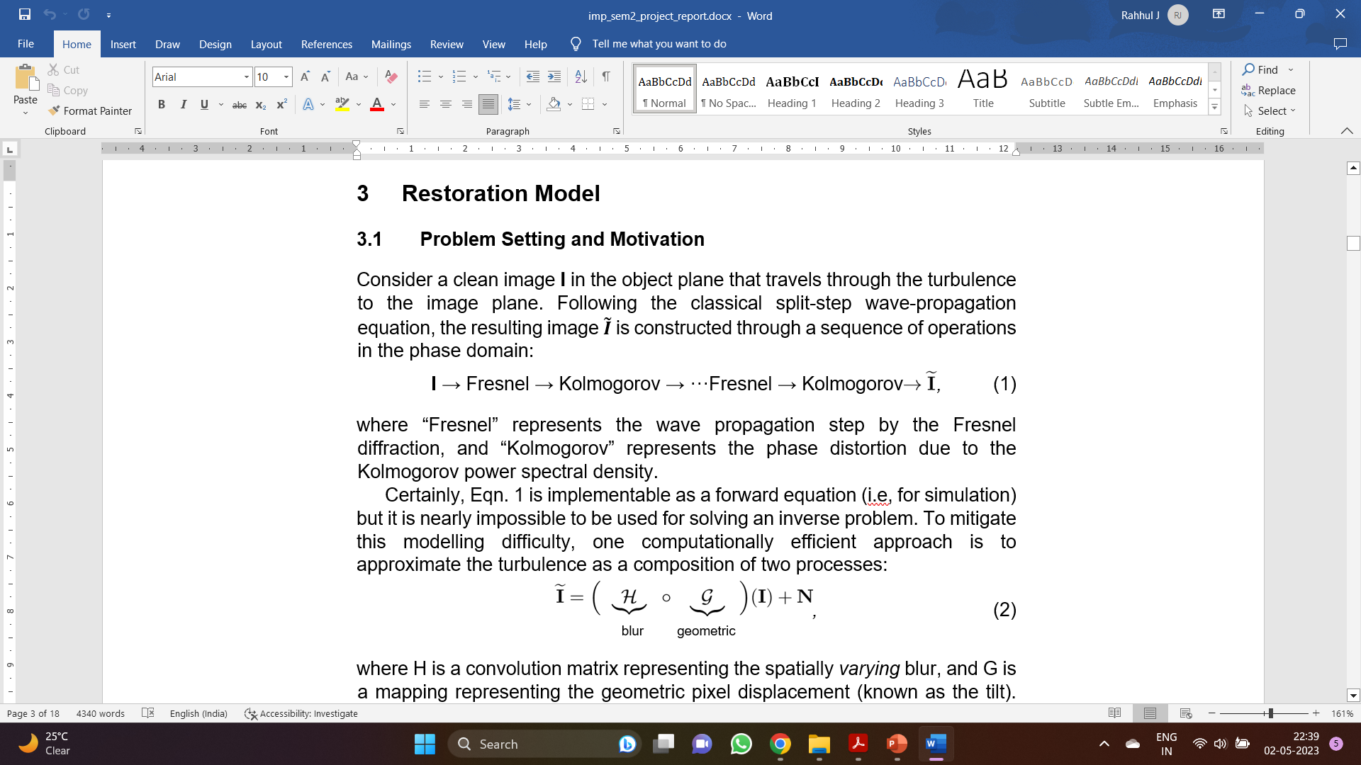
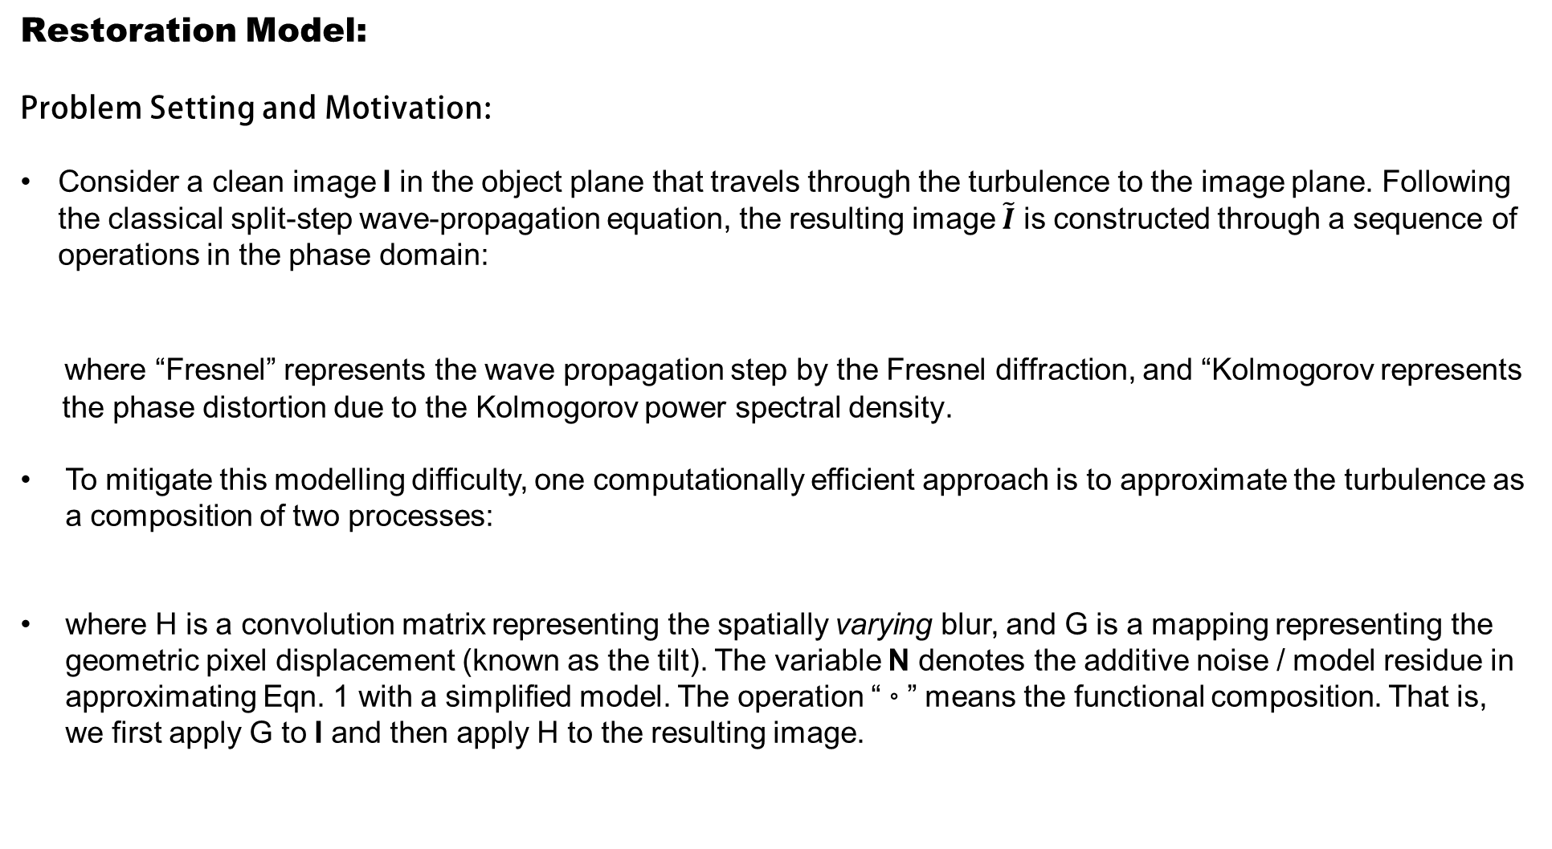
Restoration Model:
Problem Setting and Motivation:
Consider a clean image I in the object plane that travels through the turbulence to the image plane. Following the classical split-step wave-propagation equation, the resulting image $\tilde{I}$ is constructed through a sequence of operations in the phase domain:
where “Fresnel” represents the wave propagation step by the Fresnel diffraction, and “Kolmogorov represents
the phase distortion due to the Kolmogorov power spectral density.
To mitigate this modelling difficulty, one computationally efficient approach is to approximate the turbulence as a composition of two processes:
where H is a convolution matrix representing the spatially varying blur, and G is a mapping representing the geometric pixel displacement (known as the tilt). The variable N denotes the additive noise / model residue in approximating Eqn. 1 with a simplified model. The operation “◦” means the functional composition. That is, we first apply G to I and then apply H to the resulting image.

Slide 8
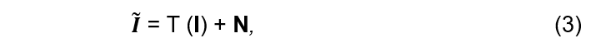
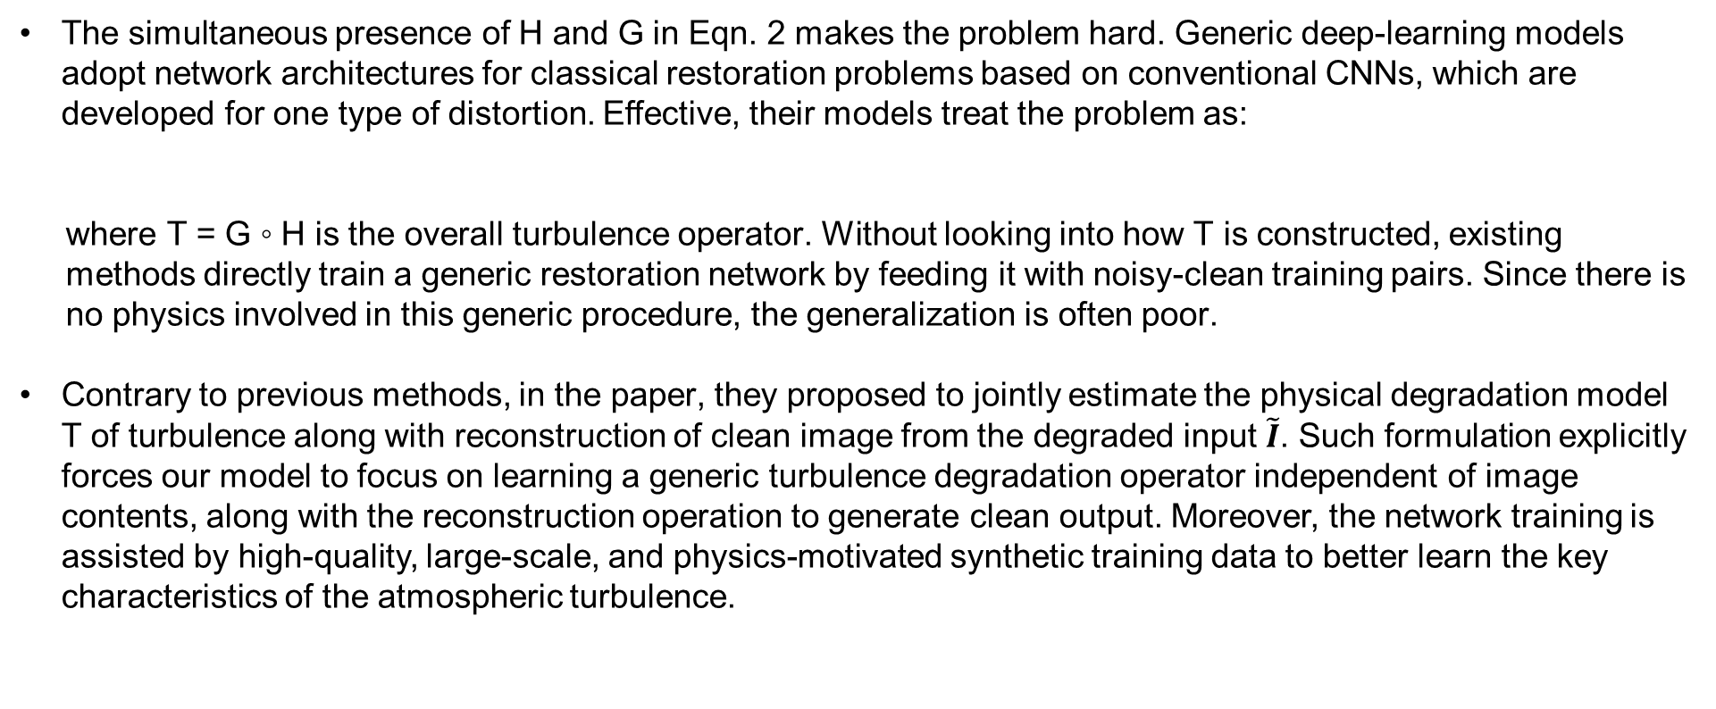
The simultaneous presence of H and G in Eqn. 2 makes the problem hard. Generic deep-learning models adopt network architectures for classical restoration problems based on conventional CNNs, which are developed for one type of distortion. Effective, their models treat the problem as:
where T = G ◦ H is the overall turbulence operator. Without looking into how T is constructed, existing
methods directly train a generic restoration network by feeding it with noisy-clean training pairs. Since there is
no physics involved in this generic procedure, the generalization is often poor.
Contrary to previous methods, in the paper, they proposed to jointly estimate the physical degradation model T of turbulence along with reconstruction of clean image from the degraded input $\tilde{I}$. Such formulation explicitly forces our model to focus on learning a generic turbulence degradation operator independent of image contents, along with the reconstruction operation to generate clean output. Moreover, the network training is assisted by high-quality, large-scale, and physics-motivated synthetic training data to better learn the key characteristics of the atmospheric turbulence.

Slide 9
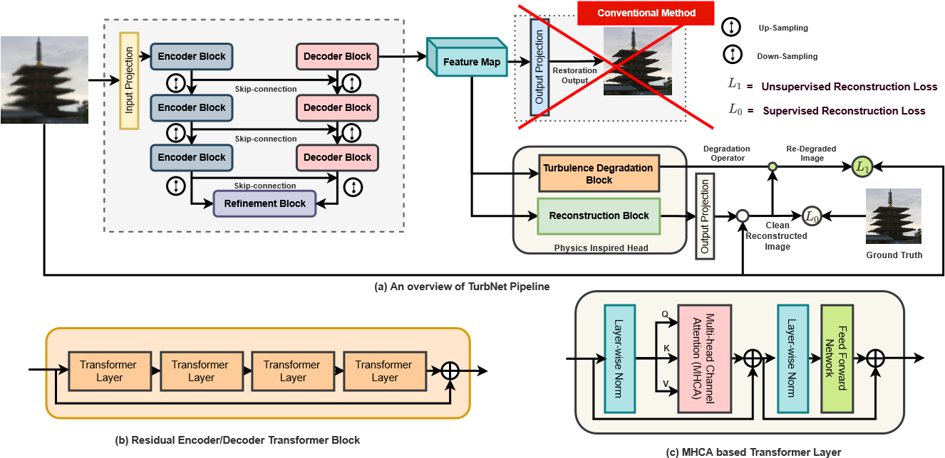
Model Architecture:
Fig.1. Architecture of the proposed method. (a) The overall architecture consists: (i) a transformer to pull the spatially dynamical features from the scene; (ii) instead of directly constructing the image, we introduce a physics-inspired model to estimate the turbulence while reconstructing the image. (b) The structure of the residual encoder/decoder transformer block. (c) The details of each transformer layer.

Slide 10
Turbulence and limitation of CNNs:
The convolutional filters cannot adapt to image content during inference due to their static weights.
The local receptive fields cannot model the long-range pixel dependencies.
Previous restoration methods treat turbulence restoration as a regression problem using CNNs but ignore the fact that turbulence is highly location adaptive and should not be represented as static fixed kernel applied to all locations. It is not difficult to see that applying static weight convolutions to regions with drastically different distortions will lead to sub-optimal performance.
The self-attention mechanism proposed can be a powerful alternative, as it can capture context-dependent global interactions by aggregating information across image regions. Leveraging the capability of multihead self-attention, we propose the TurbNet, a transformer-based end-to-end network for restoring turbulence degraded images.
Transformer-based architecture allows the creation of input-adaptive and location-adaptive filtering effect using key, query, and weight, where key and query decide content-adaptivity while weight brings location-adaptivity. Our design, as shown in Figure 1, is composed of several key building blocks:

Slide 11
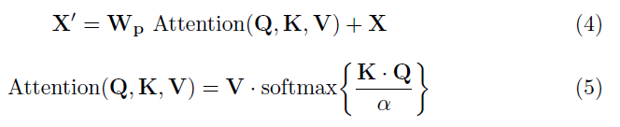
Transformer Backbone:
The proposed network consists of a transformer based backbone that has the flexibility of constructing an input-adaptive and location-adaptive unique kernel to model spatially- and instance-varying turbulence effect. TurbNet adopts a U-shape encoder-decoder architecture due to its hierarchical multi-scale representation while remaining computationally efficient.
Our backbone consists of three modules: input projection, deep encoder and decoder module. Input project module uses convolution layers to extract low frequency information and induces dose of convolutional inductive bias in early stage and improves representation learning ability of transformer blocks. Deep encoder and decoder modules are mainly composed of a sequential cascade of Multi-head channel attention (MHCA) based transformer layers. Compared to prevalent CNN-based turbulence mitigation models, this design allows content-based interactions between image content and attention weights, which can be interpreted as spatially varying convolution.
The primary challenge of applying conventional transformer blocks for image restoration task comes from the quadratic growth of key-query dot product interactions, i.e., O(W²H²), for images with W ×H pixels. To alleviate this issue, we adopt the idea of applying self-attention across channels instead of spatial dimension [37], and compute cross-covariance across channels generating attention map. Given query (Q), key (K), and value (V), we reshape Q and K such that their dot-product generates a transposed-attention map A ∈ R^{C×C}, instead of conventional R^{HW×HW} [5]. Overall, the MHCA can be summarized as:

Slide 12
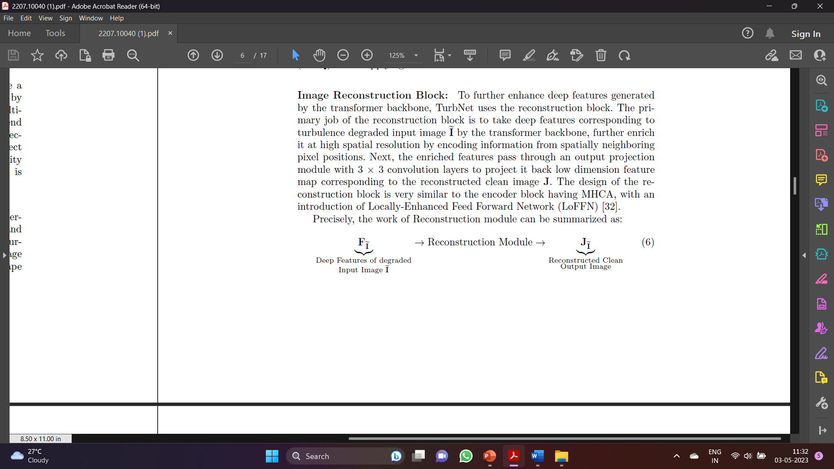
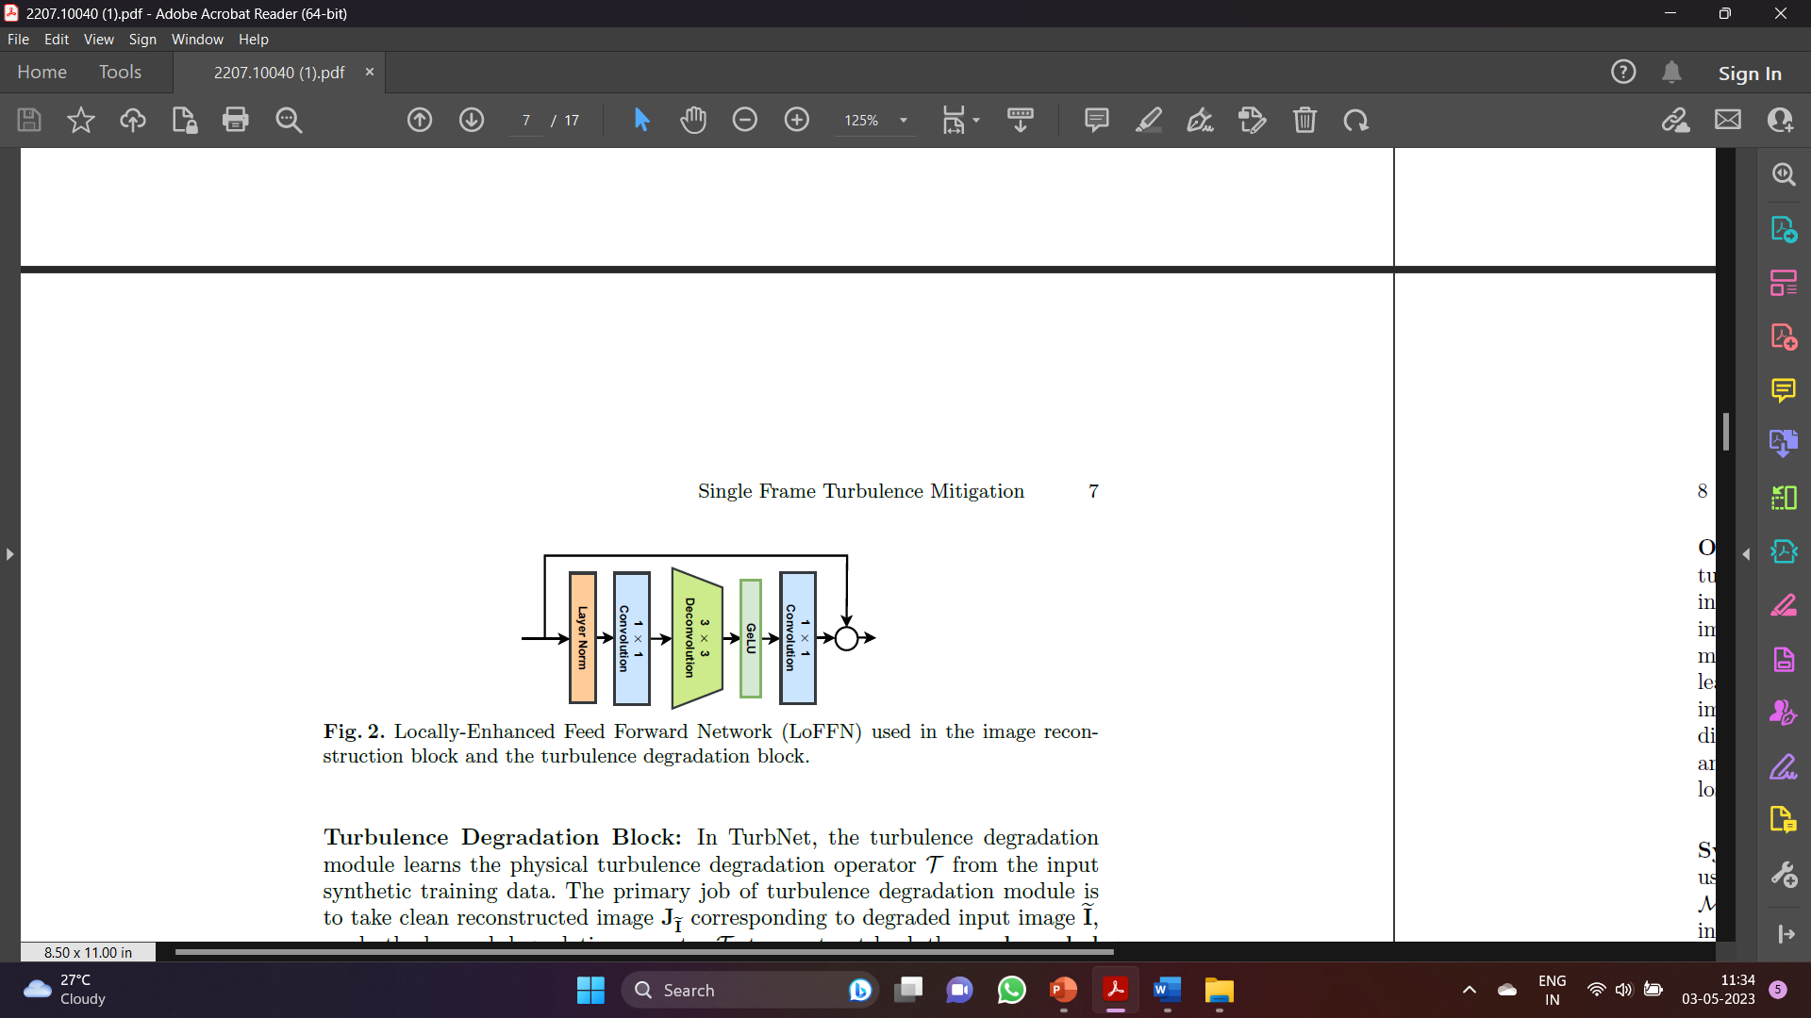
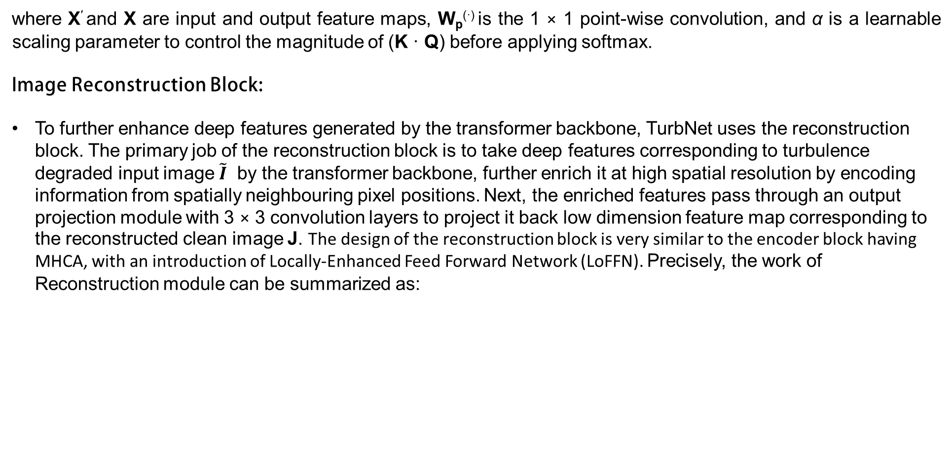
where X′ and X are input and output feature maps, W_{p}^{(·)} is the 1 × 1 point-wise convolution, and α is a learnable scaling parameter to control the magnitude of (K · Q) before applying softmax.
Image Reconstruction Block:
To further enhance deep features generated by the transformer backbone, TurbNet uses the reconstruction block. The primary job of the reconstruction block is to take deep features corresponding to turbulence degraded input image $\tilde{I}$ by the transformer backbone, further enrich it at high spatial resolution by encoding information from spatially neighbouring pixel positions. Next, the enriched features pass through an output projection module with 3 × 3 convolution layers to project it back low dimension feature map corresponding to the reconstructed clean image J. The design of the reconstruction block is very similar to the encoder block having MHCA, with an introduction of Locally-Enhanced Feed Forward Network (LoFFN). Precisely, the work of Reconstruction module can be summarized as:

Slide 13
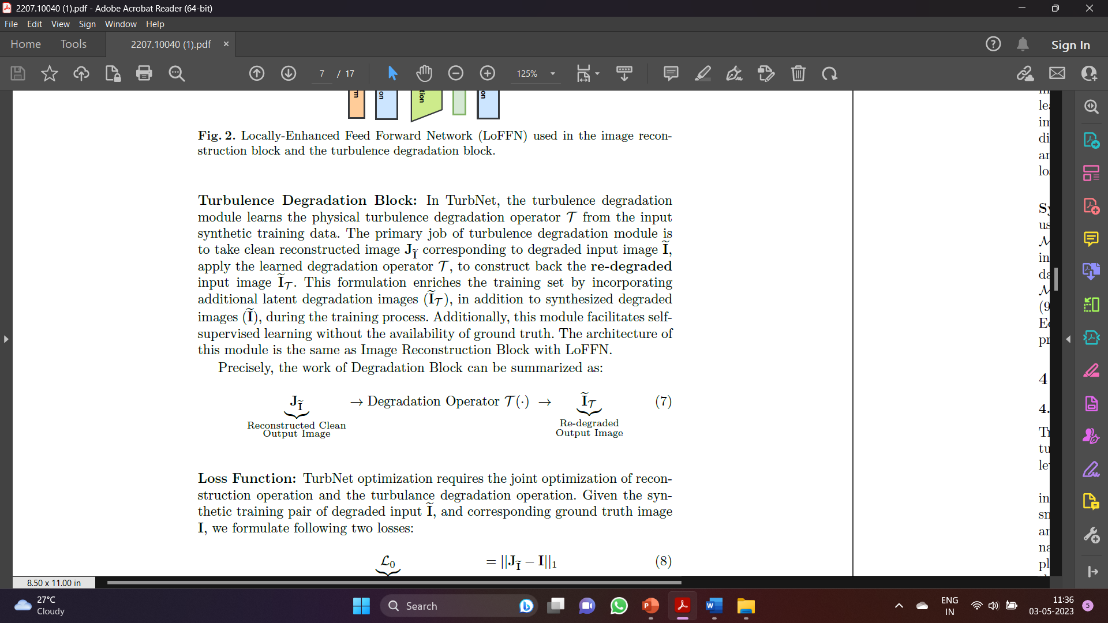
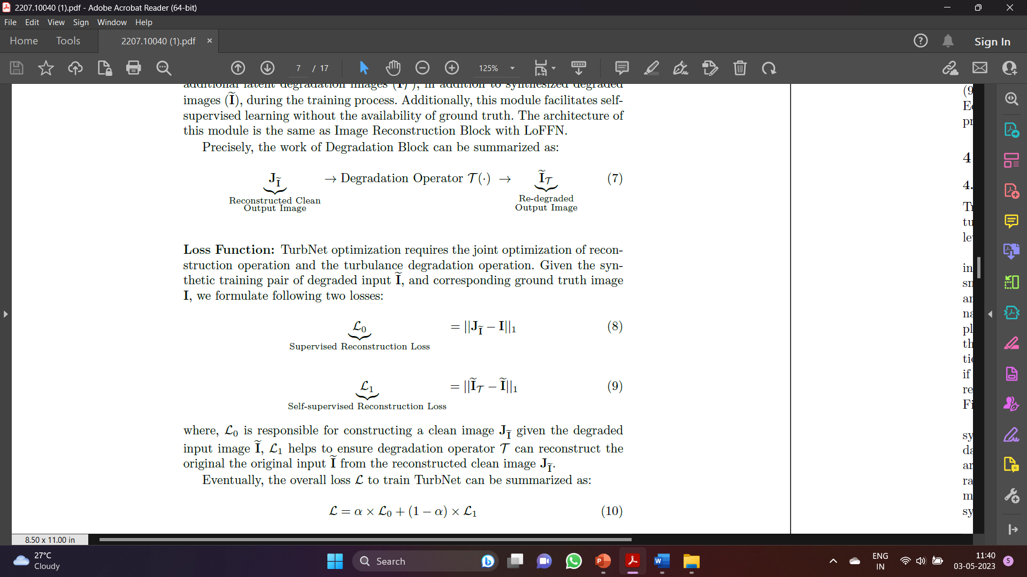
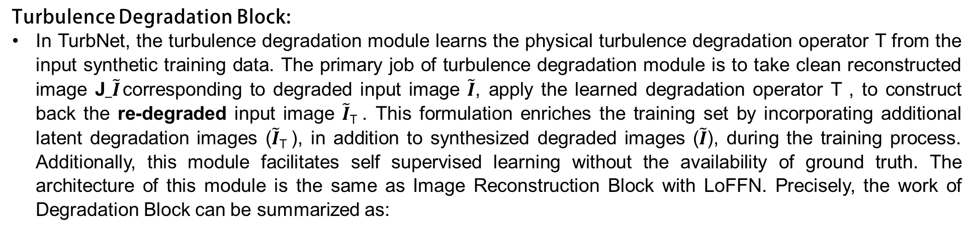
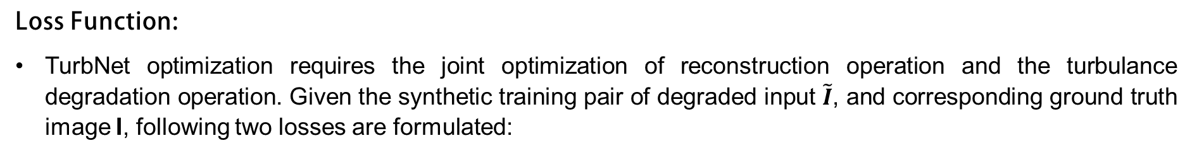
Turbulence Degradation Block:
In TurbNet, the turbulence degradation module learns the physical turbulence degradation operator T from the input synthetic training data. The primary job of turbulence degradation module is to take clean reconstructed image J$_\tilde{I}$ corresponding to degraded input image $\tilde{I}$, apply the learned degradation operator T , to construct back the re-degraded input image $\tilde{I}$_{T} . This formulation enriches the training set by incorporating additional latent degradation images ($\tilde{I}$_{T} ), in addition to synthesized degraded images ($\tilde{I}$), during the training process. Additionally, this module facilitates self supervised learning without the availability of ground truth. The architecture of this module is the same as Image Reconstruction Block with LoFFN. Precisely, the work of Degradation Block can be summarized as:
Loss Function:
TurbNet optimization requires the joint optimization of reconstruction operation and the turbulance degradation operation. Given the synthetic training pair of degraded input $\tilde{I}$, and corresponding ground truth image I, following two losses are formulated:

Slide 14
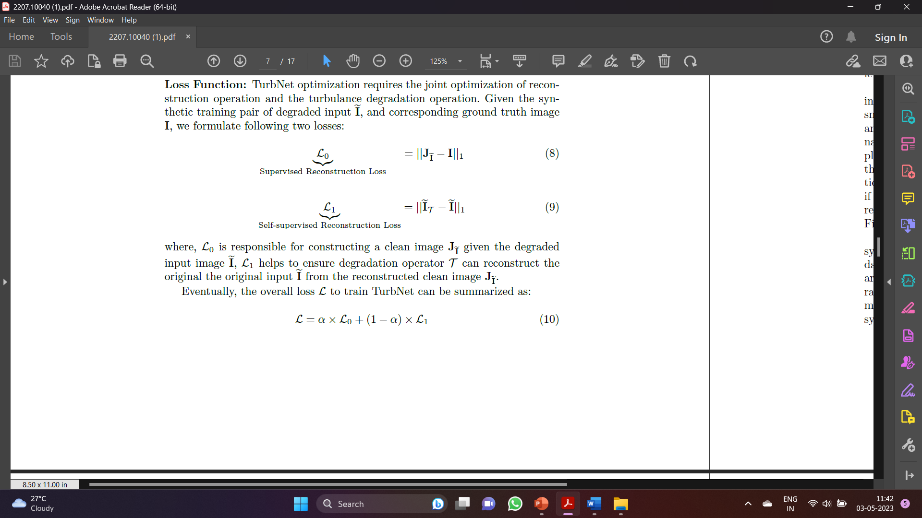
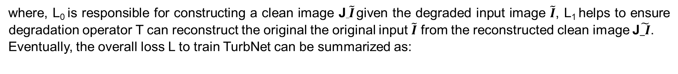
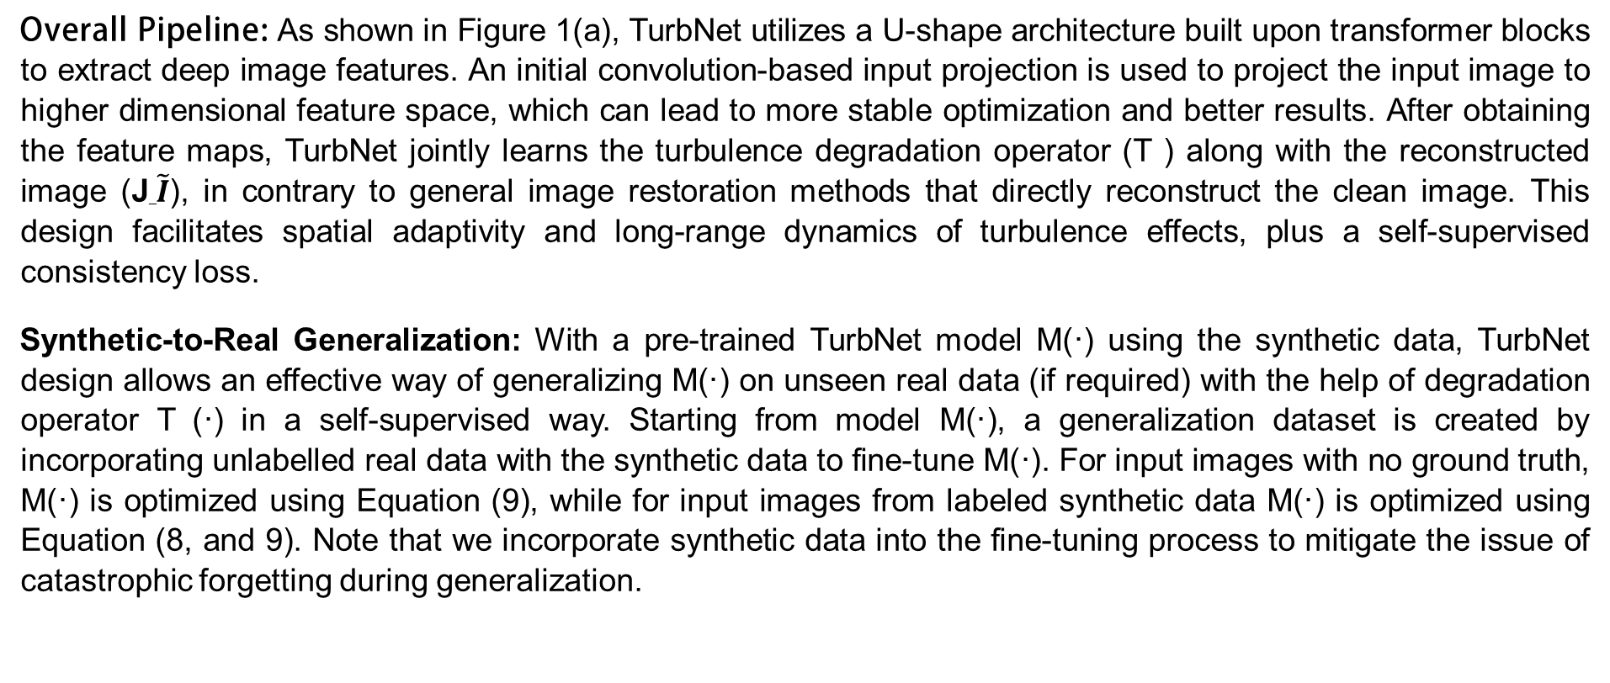
where, L₀ is responsible for constructing a clean image J_$\tilde{I}$ given the degraded input image $\tilde{I}$, L₁ helps to ensure degradation operator T can reconstruct the original the original input $\tilde{I}$ from the reconstructed clean image J$\tilde{_I}$.
Eventually, the overall loss L to train TurbNet can be summarized as:
Overall Pipeline: As shown in Figure 1(a), TurbNet utilizes a U-shape architecture built upon transformer blocks to extract deep image features. An initial convolution-based input projection is used to project the input image to higher dimensional feature space, which can lead to more stable optimization and better results. After obtaining the feature maps, TurbNet jointly learns the turbulence degradation operator (T ) along with the reconstructed image (J_$\tilde{I}$), in contrary to general image restoration methods that directly reconstruct the clean image. This design facilitates spatial adaptivity and long-range dynamics of turbulence effects, plus a self-supervised consistency loss.
Synthetic-to-Real Generalization: With a pre-trained TurbNet model M(·) using the synthetic data, TurbNet design allows an effective way of generalizing M(·) on unseen real data (if required) with the help of degradation operator T (·) in a self-supervised way. Starting from model M(·), a generalization dataset is created by incorporating unlabelled real data with the synthetic data to fine-tune M(·). For input images with no ground truth, M(·) is optimized using Equation (9), while for input images from labeled synthetic data M(·) is optimized using Equation (8, and 9). Note that we incorporate synthetic data into the fine-tuning process to mitigate the issue of catastrophic forgetting during generalization.

Slide 15

Large-Scale Training and Testing Datasets:
Training a deep neural network requires data, but the real clean-noisy pair of turbulence is nearly impossible to collect. A more feasible approach here is to leverage a powerful turbulence simulator to synthesize the turbulence effects.
Deep Learning Turbulence simulation model generates the geometric distortions by repeatedly smoothing a set of random spikes, and the blur is assumed to be spatially invariant Gaussian. We argue that for the face images studied, the narrow field of view makes their simplified model valid. However, for more complex scenarios, such a simplified model will fail to capture two key phenomena that could cause the training of the network to fail:
(1) The instantaneous distortion of the turbulence can vary significantly from one observation to another even if the turbulence parameters are fixed. See Figure 3(a) for an illustration from a real data.
(2) Within the same image, the distortions are spatially varying. See Figure 3(b).

Slide 16
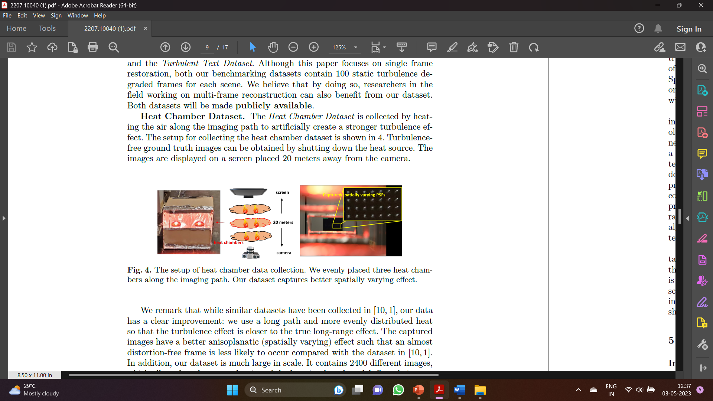

Testing Data: Heat Chamber and Text Datasets:
The real benchmarking dataset consists of two parts: the Heat Chamber Dataset and the Turbulent Text Dataset. benchmarking datasets contain 100 static turbulence degraded frames for each scene.
Heat Chamber Dataset: The Heat Chamber Dataset is collected by heating the air along the imaging path to artificially create a stronger turbulence effect. The setup for collecting the heat chamber dataset is shown in 4. Turbulence free ground truth images can be obtained by shutting down the heat source. The images are displayed on a screen placed 20 meters away from the camera.
It contains 2400 different images, which allows for a better evaluation of the learning-based model.

Slide 17
Turbulence Text Dataset:
Due to the nature of the problem, it is extremely difficult, if not impossible, to capture
ground truth clean images in truly long-range settings. Therefore, we adopt the idea of using the performance of
high-level vision task as an evaluation metric for image restoration. Specifically, we calculate the detection ratio and
longest common subsequence on the output of an OCR algorithm as the evaluation metrics.
There are several advantages of using text recognition:
1) The degradation induced by atmospheric turbulence, the geometric distortion and the loss of resolution, can be
directly reflected by the text patterns. Both types of degradation need to be removed for the OCR algorithms to
perform well.
2) The OCR is a mature application. The selected algorithms should be able to recognize the text patterns as long as
the turbulence is removed. Other factors such as the domain gap between the training and testing data will not
affect the evaluation procedure as much as other high-level vision tasks.
3) An important factor to consider when designing the dataset is whether the difficulty of the task is appropriate.
The dataset should neither be too difficult such that the recognition rate cannot be improved by the restoration
algorithms nor too easy making all algorithms perform similarly. We can easily adjust the font size and contrast of
text patterns to obtain a proper difficulty level.
The Turbulence Text Dataset consists of 100 scenes, where each scene contains 5 text sequences. Each scene has 100 static frames.

Slide 18
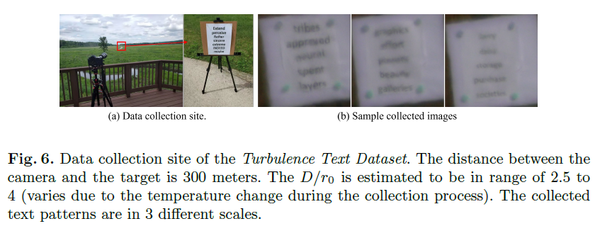
Experiment Results:
TurbNet uses a 4-staged symmetric encoder-decoder architecture, where stage 1, 2, 3, and 4 consist of 4, 6, 6, and 8 MHCA-based transformer layers respectively. Our Reconstruction block and Turbulence Degradation block consist of 4 MHCA-transformer layers enhanced with LoFFN.
TurbNet is trained using 50,000 synthetic dataset generated using a physics-based stimulator and MIT Places dataset while synthetic evaluation results are generated on 5,000 synthetic images. Due to resource constraint, our synthetic training uses a batch size of 8 with Adam optimizer. We start our training with learning rate of 1e − 4, and use the cosine annealing scheduler to gradually decrease the learning rate over the span of 50 epcohs. During training, to modulate between the loss Equation 8 and 9, we have use α to be 0.9.
Synthetic and Heat Chamber Dataset Results
We first conduct an experiment on a synthetic testing dataset generated with the same distribution as testing data. In Figure 7, we show a qualitative comparison between our restored images with ground truth. It can be seen that our results are accurately reconstructed with the assist from estimated turbulence map.

Slide 19
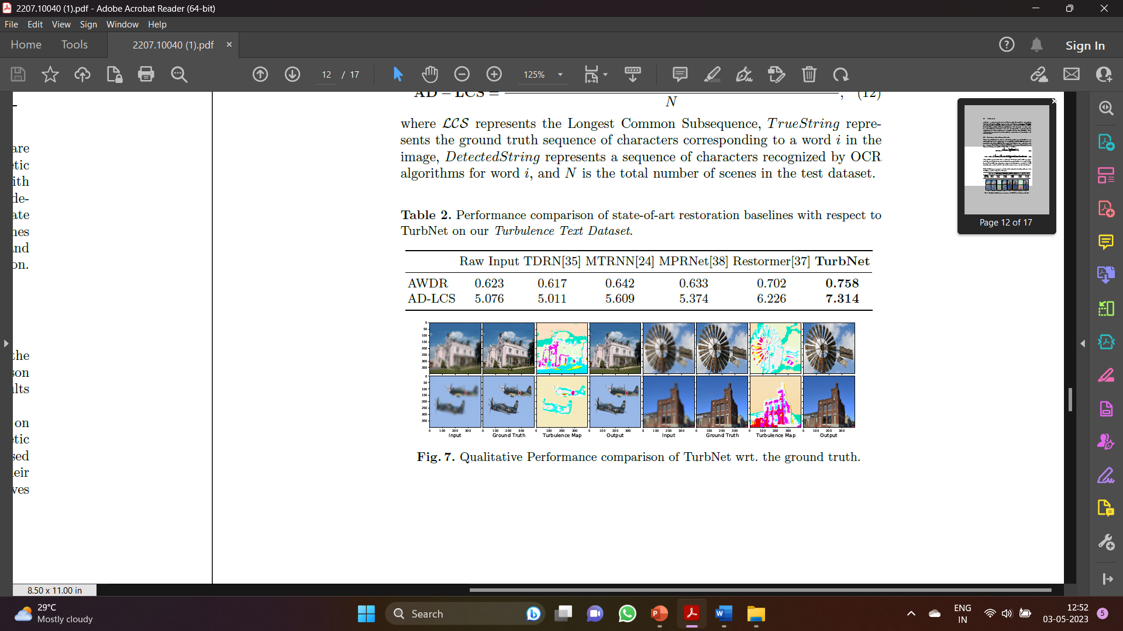

We then compare our results qualitatively with the existing algorithms on both synthetic and Heat Chamber dataset. A Visual comparison on the synthetic dataset can be found in Figure 8. It can be observed that the transformer-based methods generally perform better than the CNN-based methods due to their ability to adapt dynamically to the distortions. The proposed method achieves authentic reconstruction due to its ability to explicitly model the atmospheric turbulence distortion.

Slide 20
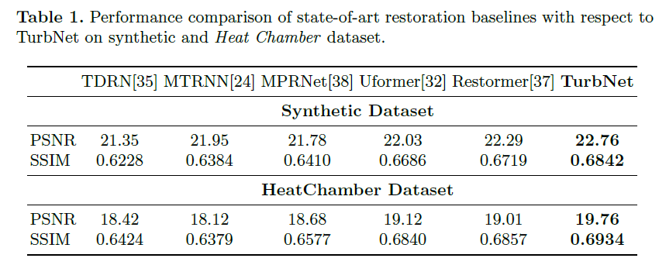
Table 1 presents the quantitative evaluation of TurbNet wrt. other baselines. TurbNet achieves the best results in both PSNR and SSIM. Note that Uformer, and Restomer (designed for classical restoration problems like deblurring, deraining, etc.) uses transformer-based encoder decoder architecture, but their performance is significantly low than TurbNet, which validates the importance of our decoupled (reconstruction and degradation estimation) design.
Turbulence Text Dataset Results:
Evaluation Method: In order to evaluate the performance of TurbNet on our real-world turbulence text dataset, we use publicly available OCR detection and recognition algorithms and we propose the following two evaluation metrics - Average Word Detection Ratio (AWDR), and Average Detected Longest Common Subsequence (AD − LCS) defined as follows:

Slide 21
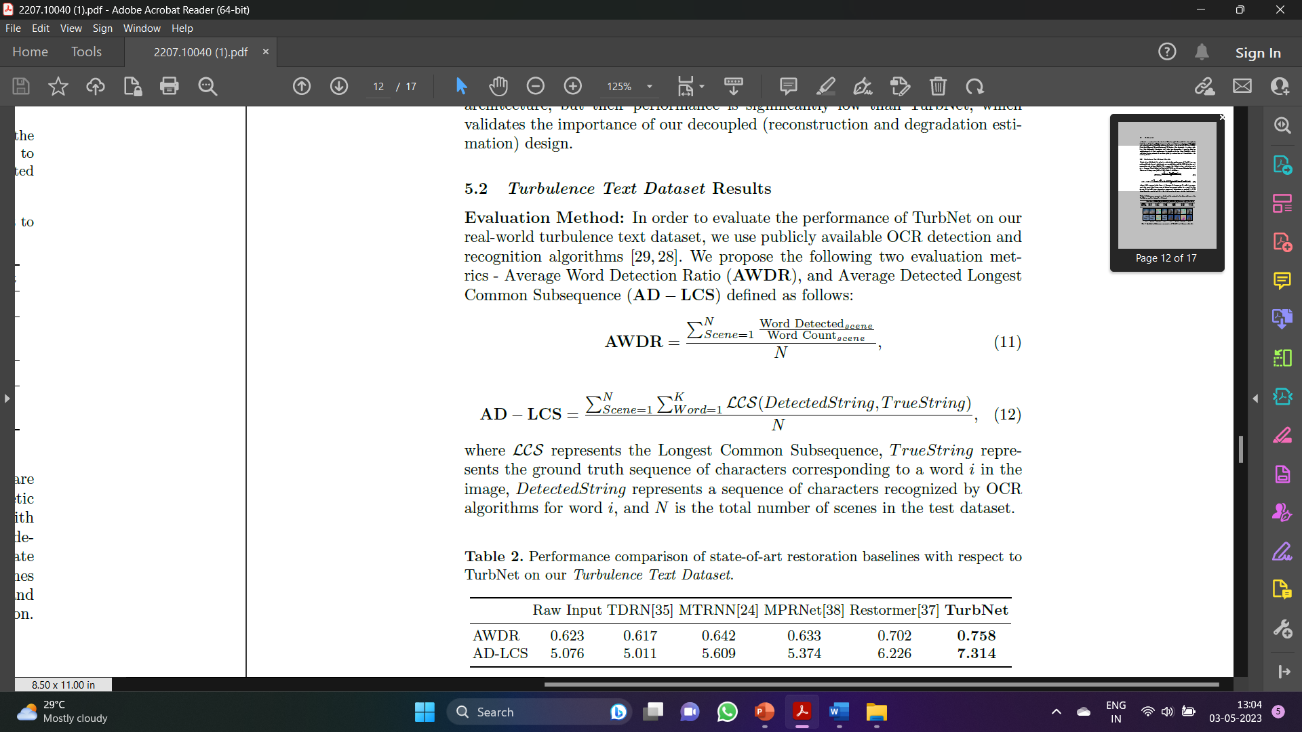
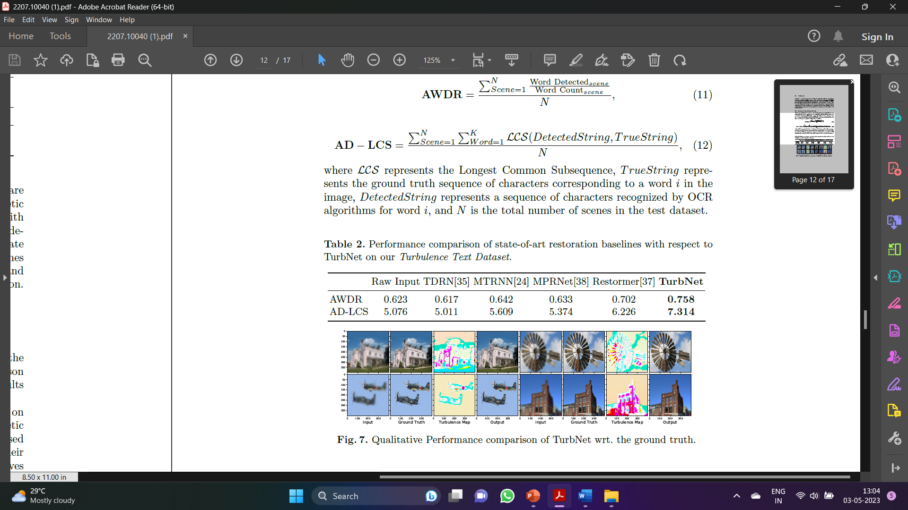
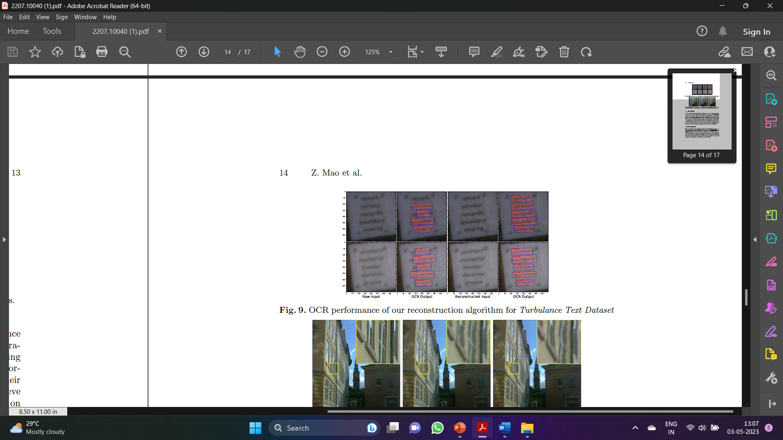
Figure 9 represents the performance of OCR on the real turbulence impacted images and images restored by TurbNet. It is evident that our restoration model significantly helps in improving the OCR performance by identifying comparatively more words with higher confidence. Table 2 presents the performance gain by TurbNet over the real turbulence degraded text images and their restored version by various state-of-the-art methods. OCR algorithms achieve massive improvements of +0.135 (AWDR) and +2.238 (AD-LCS) when used on images restored by TurbNet compared to being used directly on real images from our proposed test dataset.

Slide 22
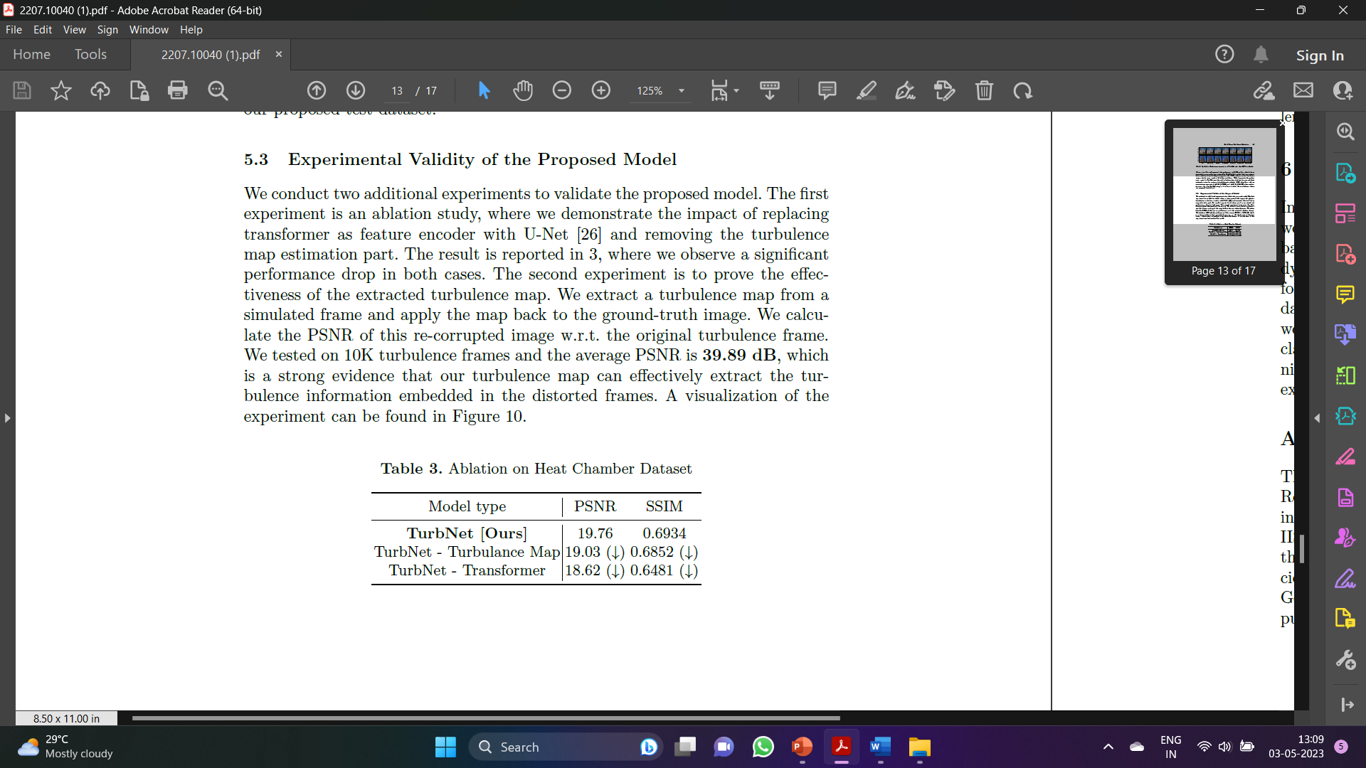
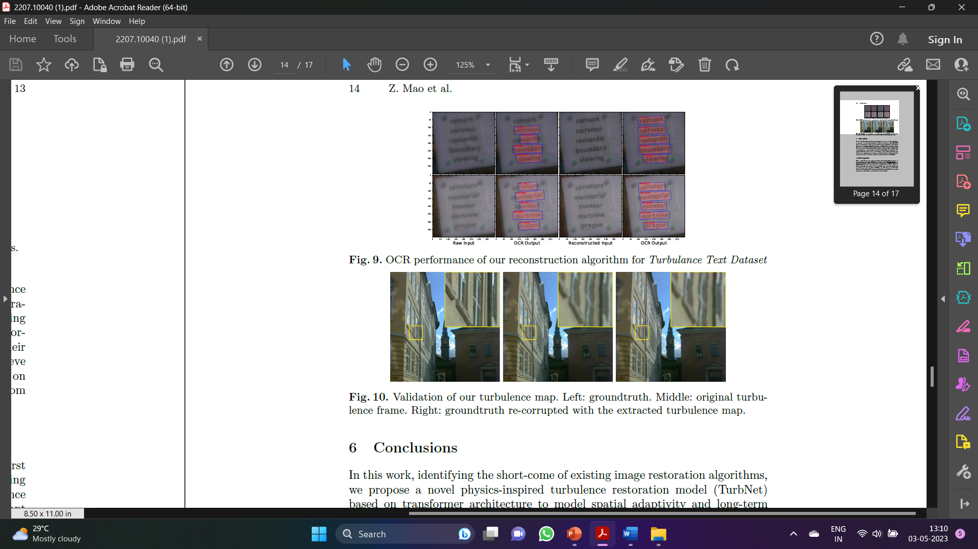
Experimental Validity of the Proposed Model:
We conduct two additional experiments to validate the proposed model. The first experiment is an ablation study, where we demonstrate the impact of replacing transformer as feature encoder with U-Net and removing the turbulence map estimation part. The result is reported in 3, where we observe a significant performance drop in both cases. The second experiment is to prove the effectiveness of the extracted turbulence map. We extract a turbulence map from a simulated frame and apply the map back to the ground-truth image. We calculate the PSNR of this re-corrupted image w.r.t. the original turbulence frame. We tested on 10K turbulence frames and the average PSNR is 39.89 dB, which is a strong evidence that our turbulence map can effectively extract the turbulence information embedded in the distorted frames.

Slide 23
Conclusions:
In this work, identifying the short-come of existing image restoration algorithms, we propose a novel physics-inspired turbulence restoration model (TurbNet) based on transformer architecture to model spatial adaptivity and long-term dynamics of turbulence effect.
We present a synthetic data generation scheme for tuning a sophisticated physics-grounded simulator to generate a large-scale dataset, covering a broad variety of atmospheric turbulence effects.
Additionally, we introduce two new large-scale testing datasets that allow for evaluation with classical objective metrics and a new task-driven metric with optical text recognition. Our comprehensive evaluation on realistic and diverse datasets leads to exposing limitations of existing methods and the effectiveness of TurbNet.
TurbNet Source Code:
The source code for the propsed TurbNet model can be found in the below Github link:
https://github.com/rahhul17/TurbNet

Slide 24
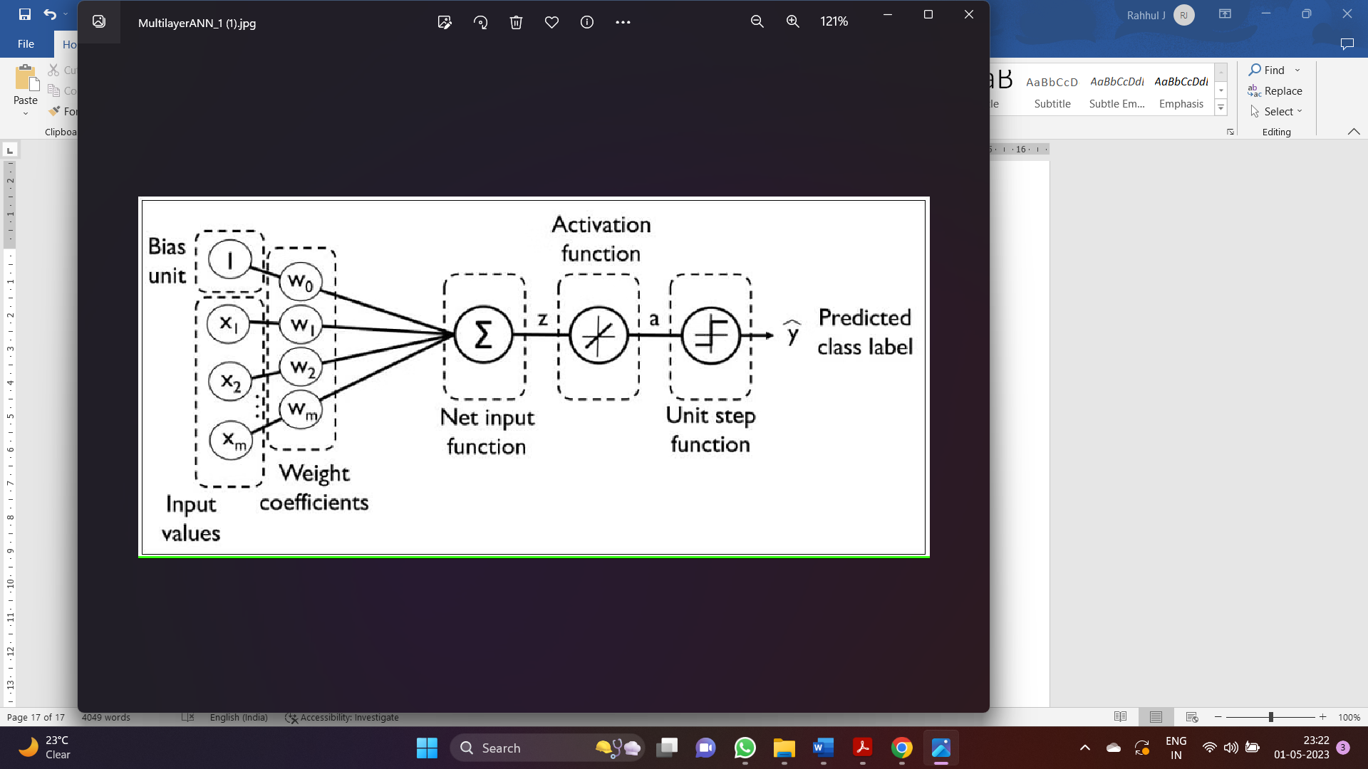
Fully Connected Multi-Layer Perceptron Network
In the next part of the project, we are going to see about the Multi-layer Perceptron Network that was designed for the objective of atmospheric turbulence mitigation. The Code for the same can be found in the below Github Link: https://github.com/rahhul17/ao_project/blob/main/ao_nn2.py
The Image below depicts the typical structure of a fully-connected Multi-layer Perceptron:
The model in the previous code is a neural network architecture for adaptive optics. It consists of four convolutional layers and three fully connected layers
The first convolutional layer takes a single-channel image as input and applies 16 filters of size 3x3 to it, with padding of 1. The output of this layer is then passed through a max-pooling layer with a kernel size of 2x2 and a stride of 2.

Slide 25
The second convolutional layer takes the output of the first layer as input and applies 32 filters of size 3x3 to it, with padding of 1. The output of this layer is then passed through another max-pooling layer.
The third convolutional layer takes the output of the second layer as input and applies 64 filters of size 3x3 to it, with padding of 1. The output of this layer is then passed through another max-pooling layer.
The fourth convolutional layer takes the output of the third layer as input and applies 128 filters of size 3x3 to it, with padding of 1. The output of this layer is then passed through another max-pooling layer.
The output of the fourth convolutional layer is flattened and passed through two fully connected layers with 512 and 256 neurons, respectively. The output of the last fully connected layer is a 2-dimensional vector, which represents the x and y position of the adaptive optics system.
The model uses ReLU activation function after each convolutional and fully connected layer, and applies dropout with a probability of 0.5 after the first two fully connected layers to reduce overfitting. The model is optimized using the Adam optimizer with a learning rate of 0.001, and the mean squared error (MSE) loss function is used as the loss metric.

